Slide 1
Web-Based Finite Automata Simulator and String Validator
SIMATS ENGINEERING Saveetha Institute of Medical and Technical Sciences Chennai-602105.
CSA1304- Theory of Computation
Sanjay Raghavendra 192411041
B. Kishanram
192421268
Supervisor
Dr.Sivagami
Professor.
SIMATS Engineering

Slide 2
Abstract
The Web-Based Finite Automata Simulator and String Validator is a full-stack application developed to simplify the understanding of finite automata in Theory of Computation. It allows users to create and visualize DFA and NFA, validate input strings, perform step-by-step simulations, and convert NFA into DFA. The system provides an interactive interface with database support to store automata, transitions, and validation results, making finite automata concepts easier to learn and demonstrate.

Slide 3
Introduction
Finite Automata is an important concept in TOC.
Manual simulation becomes difficult for complex inputs.
This project provides an interactive web-based solution.
Users can create and visualize DFA and NFA.

Slide 4
Problem Statement
Manual DFA/NFA simulation takes more time.
Transition errors can occur during manual checking.
State diagrams are difficult to manage manually.
Limited support for report generation and analysis history.
A simple interactive web simulator is required.

Slide 5
Objectives
Develop a web-based DFA and NFA simulator.
Provide interactive automata visualization.
Validate input strings automatically.
Perform step-by-step state simulation.
Convert NFA into equivalent DFA.

Slide 6
Literature Survey
SI.NO | Year of Publication | Authors | Tittle of the Publication | Findings | Limitations
1 | 2022 | Cavalcante et al. | JFLAP 4.0 | Interactive automata visualization | Desktop-based
2 | 2023 | Rodger et al. | Engagement with JFLAP | Improves automata learning | Education-focused
3 | 2023 | Vázquez de Parga et al. | DFA Learning Using JFLAP | Visualizes DFA learning | DFA-focused
4 | 2024 | D’Antoni et al. | Automata Tutor v3 | Automated feedback | Assessment-focused
5 | 2025 | Mohammed et al. | Formal Language Visualizations | Interactive learning support | eTextbook-focused

Slide 7
Proposed Work
Develop a web-based DFA and NFA simulator.
Create and visualize states and transitions.
Implement automatic string validation.
Provide step-by-step automata simulation.
Implement NFA-to-DFA conversion.

Slide 8
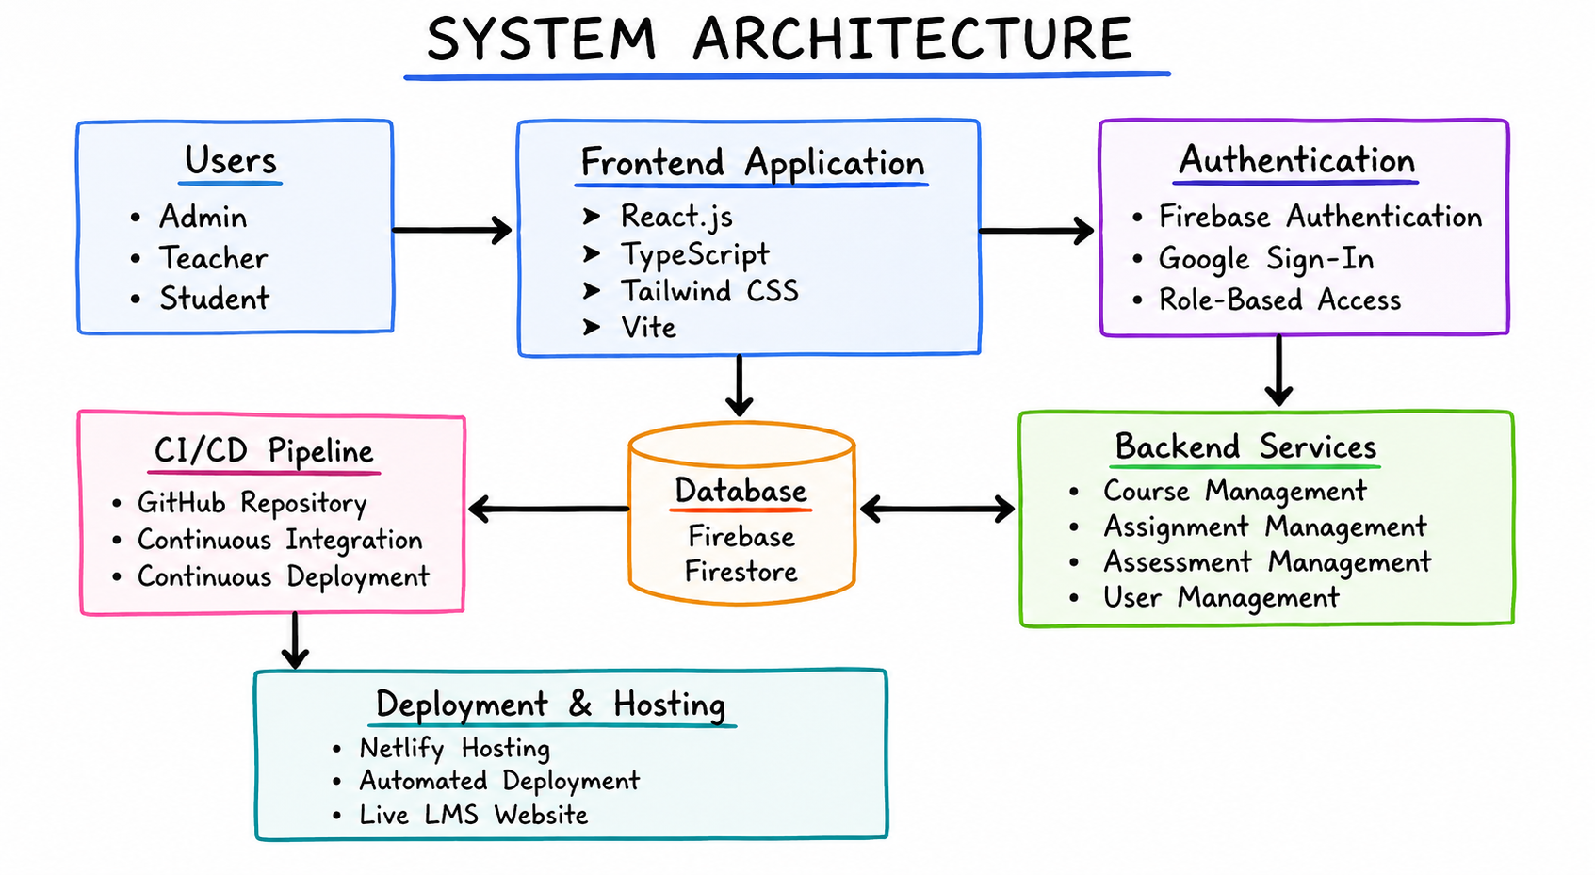
System Architecture / Workflow
Create DFA / NFA
Define States & Transitions
Enter Input String
Simulate & Validate String.
Display & Store Result

Slide 9
Module 1: Automata Creation
Create DFA and NFA.
Add and delete states.
Define input alphabets.
Select initial and final states.
Create and manage transitions.

Slide 10
Module 2: Automata Visualization
Interactive state diagram.
Final states shown separately.
States represented using circles.
Dynamic diagram updates.
Directed transition arrows.

Slide 11
Module 3: String Validator
Enter an input string.
Process symbols using transitions.
Validate DFA and NFA strings.
Display transition path.
Show Accepted / Rejected result.

Slide 12
Module 4: Step-by-Step Simulator
Processes one symbol at a time.
Displays the complete transition path.
Highlights the current state.
Provides Play, Pause, Next and Reset controls.
Shows the current input symbol.

Slide 13
Module 5: NFA to DFA Conversion
Select an existing NFA.
Apply Subset Construction Algorithm.
Generate equivalent DFA states.
Generate DFA transition table.
Visualize and save the converted DFA.

Slide 14
Evaluation And Testing
Create and Configure DFA / NFA
Define States, Alphabets and Transitions
Enter and Validate Input Strings
Perform Step-by-Step Automata Simulation
Display Accepted / Rejected Results

Slide 15
Implementation

Slide 16
Conclusion & Future Work
Successfully creates DFA/NFA.
Visualizes state transitions.
Converts NFA into DFA.
Validates input strings.

Slide 17
References
Hopcroft, J. E., Motwani, R., & Ullman, J. D., Introduction to Automata Theory, Languages, and Computation, Pearson.
Sipser, M., Introduction to the Theory of Computation, Cengage Learning.
Peter Linz, An Introduction to Formal Languages and Automata, Jones & Bartlett Learning.
Aho, A. V., Lam, M. S., Sethi, R., & Ullman, J. D., Compilers: Principles, Techniques, and Tools, Pearson.
Lewis, H. R., & Papadimitriou, C. H., Elements of the Theory of Computation, Pearson.

Slide 18
Thank You

